Slide 1
Comparative Performance Analysis of using Machine Learning algorithms for Fraud Detection in Insurance Claim Process MSC Data Science
Name: J.A.D. Meleeshiya Jayakody
Supervisor : DR Jacqueline Campbell

Slide 2
Introduction
Insurance fraud can define as knowingly making a fictitious claim, inflating a claim or adding extra items to a claim, or being in any way dishonest with the intention of gaining more than legitimate entitlement (Gill et al. 2005) and detecting such fraudulent activities can be challenging due to the huge variety of patterns involved. So, insurance companies hence along with organizations that fight against crimes and the government sector are searching for ways to detect these frauds and reduce them (Urunkar et al. 2022).
By exploring ML related methods for detecting insurance fraud, this study can contribute to reducing fraudulent activities in the auto-mobile insurance industry.

Slide 3
Aim and Objectives
AIM :
To conduct a comparative performance analysis of the usage of Machine Learning (ML) algorithms (Logistic Regression, Gradient Boost, Random Forest, Decision Tree, Support Vector Machine, Ada Boost, Multi-Layer Perceptron, and K-Nearest Neighbour) for fraud detection in the vehicle insurance claim process and identify the most effective and efficient method of using ML algorithm for fraud detection.
Objectives :
To conduct a literature review on the usage of ML algorithms for identifying fraud detection in the vehicle insurance claim process.
To investigate and finalize a car insurance claim process dataset to apply ML algorithms
To apply feature selection methods to the data set and choose the important features
To build hypothesis related to case study and validate their accuracy using T-Tests
To apply selected ML techniques to predict fraud detection and get performance results for each method
To present the findings and recommendations based on the collected results
To conduct a comparative performance analysis of used ML algorithms
To evaluate the proposed project process

Slide 4
RATIONALE
Insurance fraud has become a global issue and cultivating amoral effects inside the communities and states, lately the estimated cost of these fraudulent activities related to insurance claims identified annually as 600 million dollars for developing countries (Hanafy and Ming 2021). This issue is not only affecting the insurance companies’ growth and earnings but also is a threat to national economic growth (Tseng et al. 2014).
Clearly manual auditing and other traditional inspection methods failed to show any successful effects to fight the frauds, these very reasons prompt academics and researchers to research, implement and develop robust ways for detecting and preventing fraud.

Slide 5
LITERATURE REVIEW
General insurance fraud detection
Automobile insurance fraud detection
What is Machine Learning
ML-based fraud detection models in automobile insurance
The way that current insurance companies use ML for fraud detection
Limitations of using ML in fraud detection in the insurance field.

Slide 6
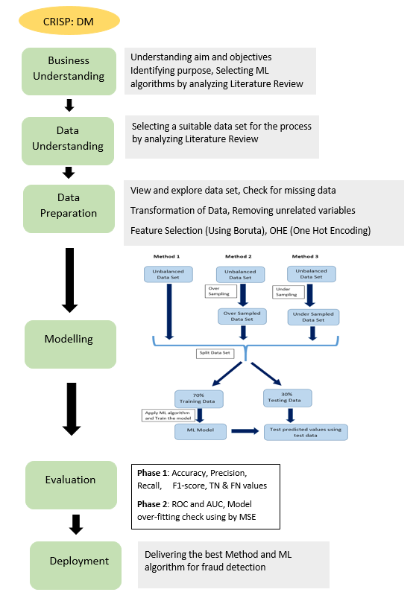
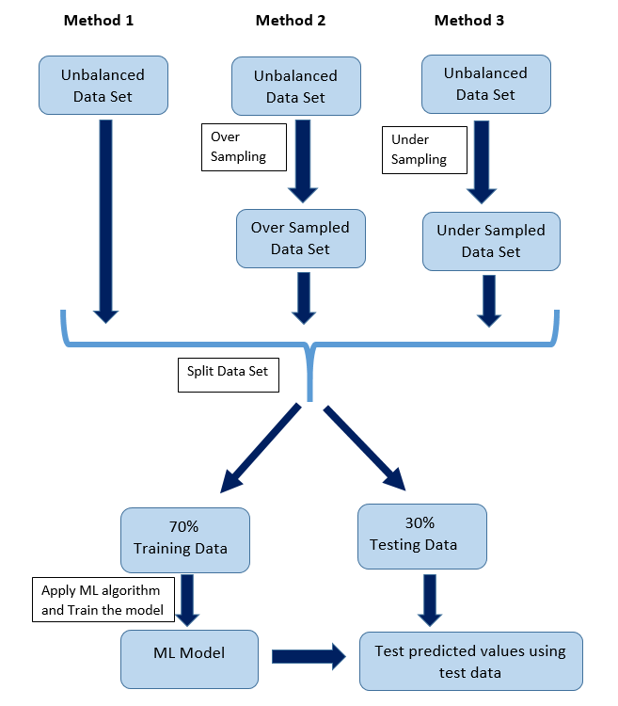
Methodology
Modelling

Slide 7
Implementation
Done using Python Language , using its’ various libraries and functions
Implemented using Jupyter Notebook

Slide 8
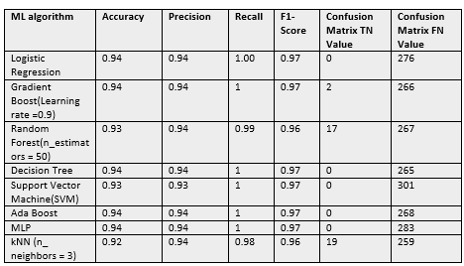
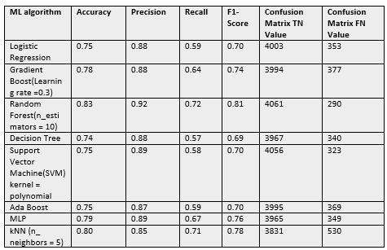
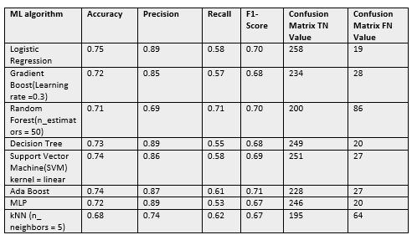
RESEARCH OUTCOME AND DISCUSSION
Method 1 (Using unbalanced Data Set)
Method 2 (Using over-sampled Data Set)
Method 3 (Using under-sampled Data Set)

Slide 9
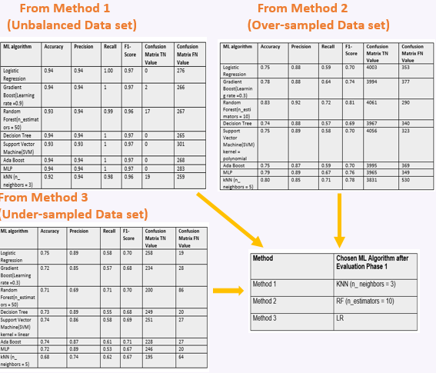
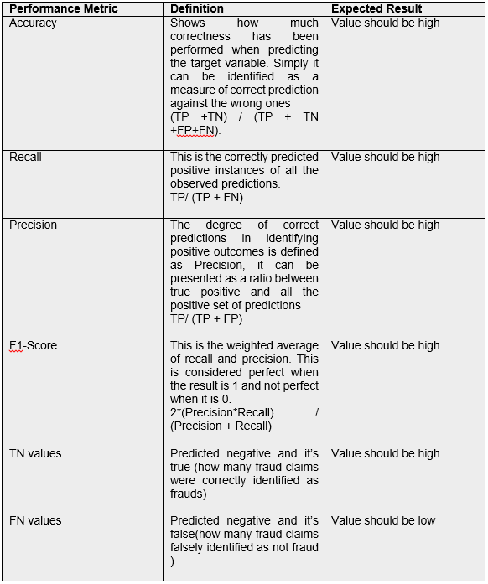
Evaluation (Phase 1)
Used Performance Metrics for Evaluation Phase 1

Slide 10
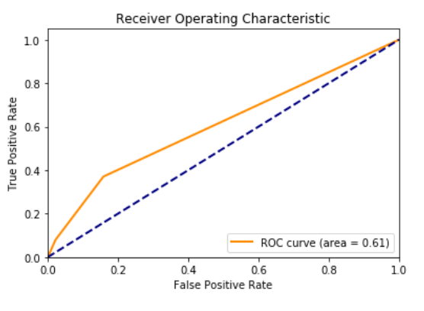
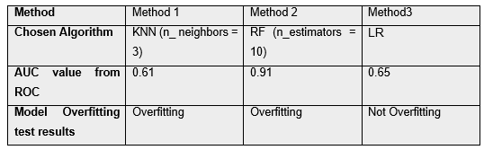
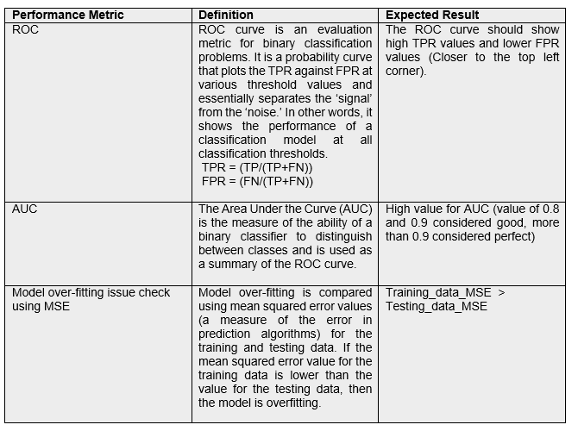
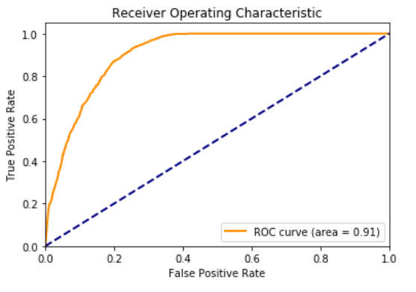
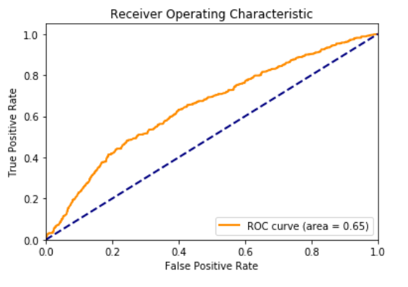
Evaluation (Phase 2)
KNN(n_neighbors = 3)
Used Performance Metrics for Evaluation Phase 2
RF (n_estimators = 10)
LR

Slide 11
Conclusion
Using the results for evaluation phase 1, comparing Method 1, Method 2 and Method 3, Method 1 was not performed well because, Method 1 were not able to show considerable TN values that mean fail to predict the fraud in the test data set.
Compared to Method 3, Method 2 showed better accuracy, precision, recall and f1-score for most of the ML algorithms.
In Method 2 Random Forest method with “n_estimators” = 10 was able to perform better than other seven ML algorithms showing highest accuracy, precision, recall, and f1-score respectively 83%,92 %, 72 % and 81%.
Also, RF was able to correctly predict highest number of fraud claims (TN values = 4061), and it has the lowest value for FN, means less number of fraud claims were miss-identified as not-frauds. The AUC value of RF was 0.91, it was an excellent model considering the AUC value.
So, over sampling on the insurance claim data set and then using Random Forest on the data set is the best way to detect fraud in the insurance claim process.

Slide 12
Future Work
This proposed proven methodology can tested using various data sets which have obtained from different vehicle insurance companies.
Collaborative Intelligence , Nowadays most significant performance for fraud detection has proven to be achieved using machines and humans working together. When AI and Human intelligence work together it can enhance creativity, teamwork, speed, scalability, and complementary strengths of each other
Since predictive analysis showing a huge improvement in the fraud detection field, this methodology should improve to build hybrid detection ML model combining AI technologies, indicators, analytical processes plus predictive models, external sources of data, and more technologies, and the system should has the ability to integrated into insurance departments with minimal help from the IT departments.

Slide 13
END

